Slide 1
Open RAN
Dian Hanifudin Subhi

Slide 2
Outline
Weekly report
Summary of this week’s work
Your work
Conclusion
Your opinion/thought
Action item

Slide 3
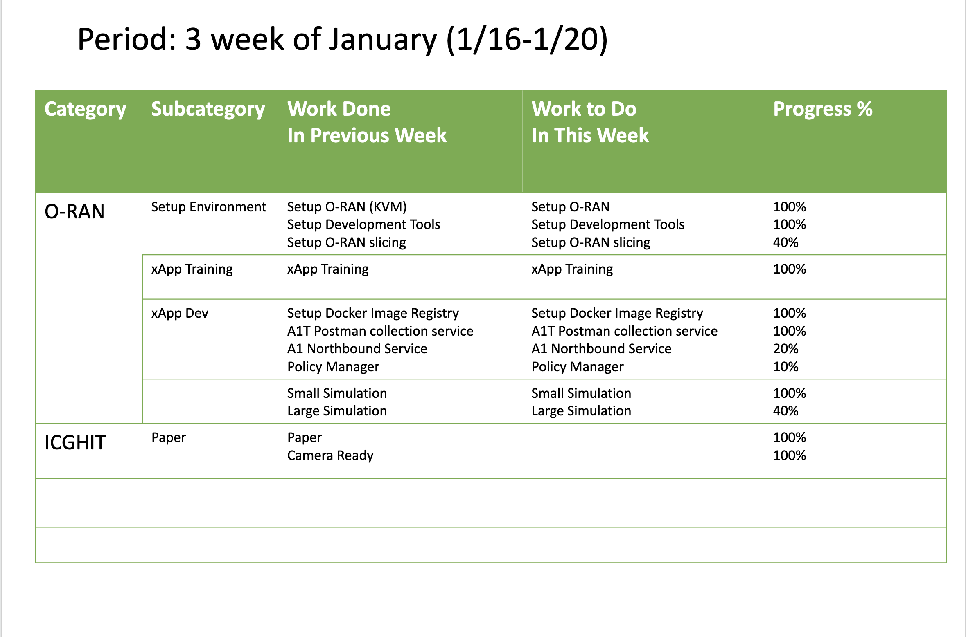
Weekly report

Slide 4
Summary of work this week
Simulate for large UE and Cells
Evaluate network slicing environment in O-RAN

Slide 5
Question to be Answered
What’s current issue to simulate large UE?
What’s current issue of RAN slicing with current environment?

Slide 6
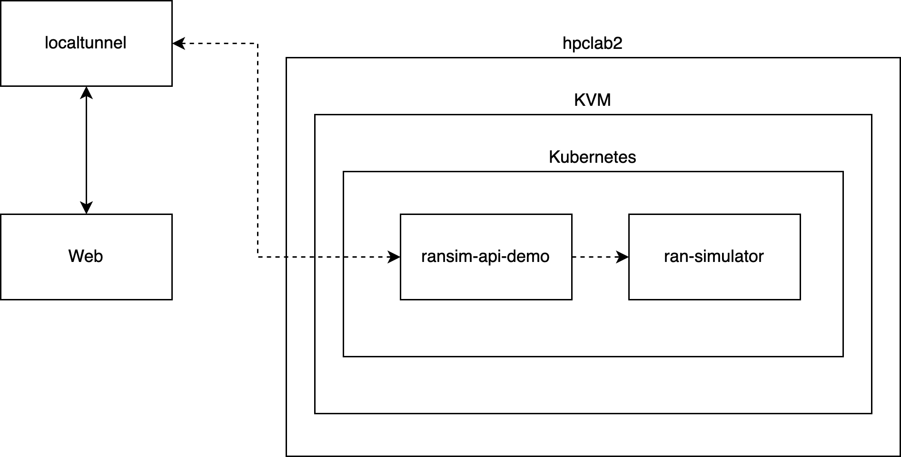
Your work
Simulate large UE and Cells
Visualization of simulation will be represented as web UI
Location of UE and cells will be grab from ran-simulator then provided by ransim-api-demo
No public IP in current VM, so we need to tunnel using localtunnel
Tunneling causes a delay, so the pod becomes unhealthy for large simulation besides the memory issues.

Slide 7
Your work
Network slicing support on O-RAN
Evaluate network slicing support using OAI nFAPI emulator based on https://docs.sd-ran.org/master/sdran-in-a-box/docs/Installation_OAI_nFAPI.html
OAI nFAPI emulator support for 1-2 UEs
RAN slicing provided by onos-rsm component service
Some issues related with RAN slice in current setup.
Only support to create one slice.
UE detach randomly

Slide 8
Conclusion
Optimization to reduce delay needed to support large simulation
Unstable RAN slicing in current setup

Slide 9
Your opinion/thought
O-RAN server needs to be located in the same network with web visualization to reduce delay.
Based on the information from slack ONF community, sometimes there is an issue with cpufreq that can cause unstable features on O-RAN. Possible solution, setup O-RAN server on another server.

Slide 10
Action items
Reduce delay, with push communication or without tunneling.
Setup O-RAN server in another server

